Slide 1
Music Player Application
صدیقه سادات غنی
شماره دانشجویی: 9773132
استاد راهنما: دکتر نادران

Slide 2
Contents
1. Introduction to Music Player
2. Features of the Music Player
4. User Interface
5. Technical Details
6. Challenges and Solutions
7. References

Slide 3
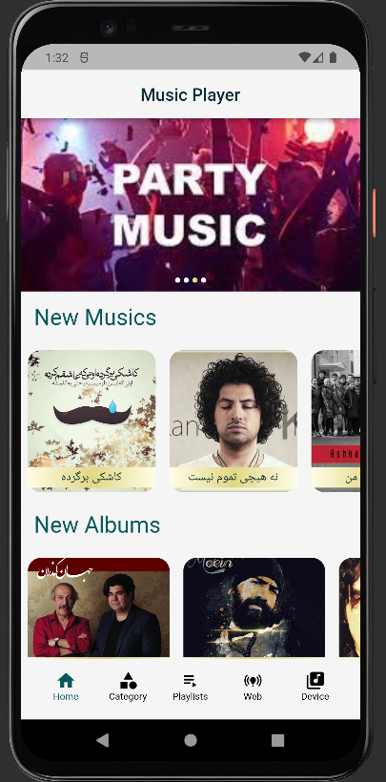
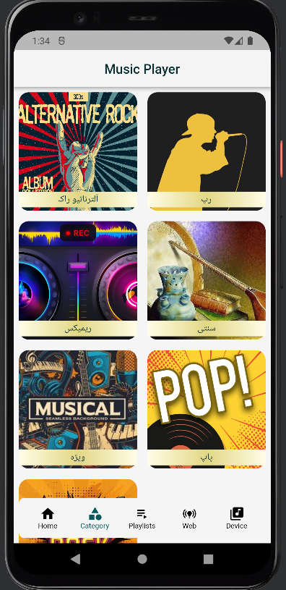
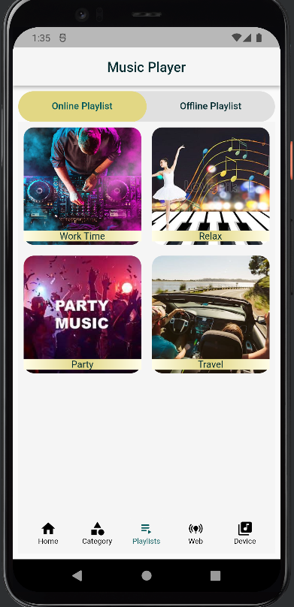
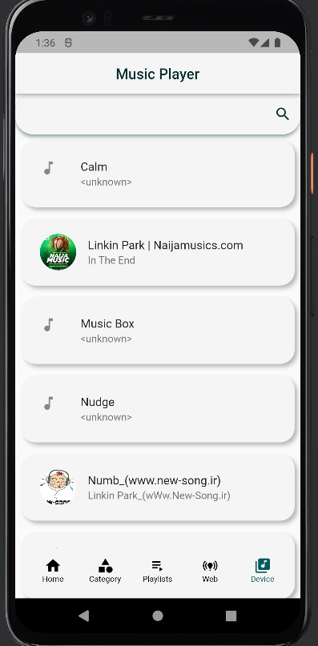
Introduction

Slide 4
Features
Play music from website and device storage
Show online Playlists and their songs
Sow online Albums and their songs
Show online Artists and their songs
Show online Categories and their songs
Show the list of online music website
Capability to enter your own music website
Capability to create playlist for device songs
Show device storage songs

Slide 5
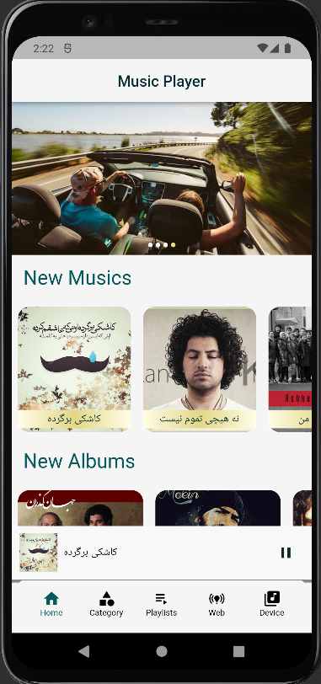
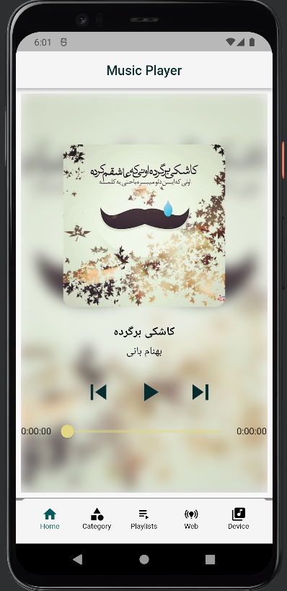
User Interface

Slide 6
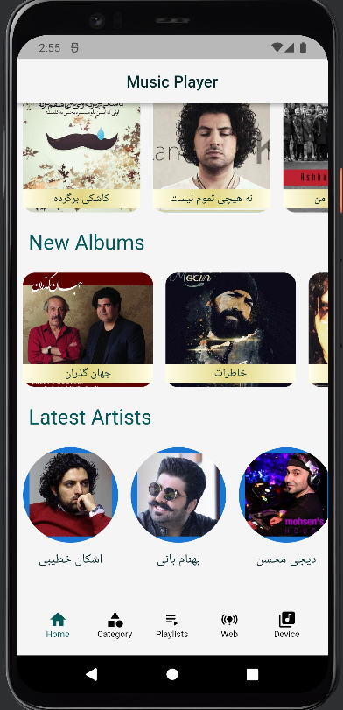
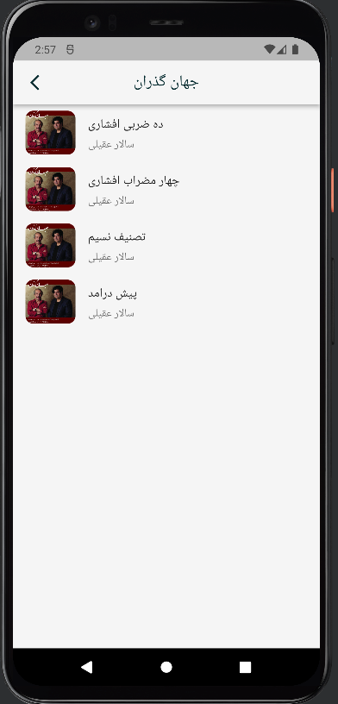
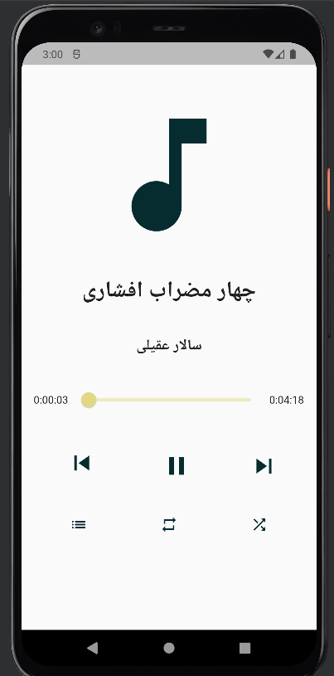
User Interface

Slide 7
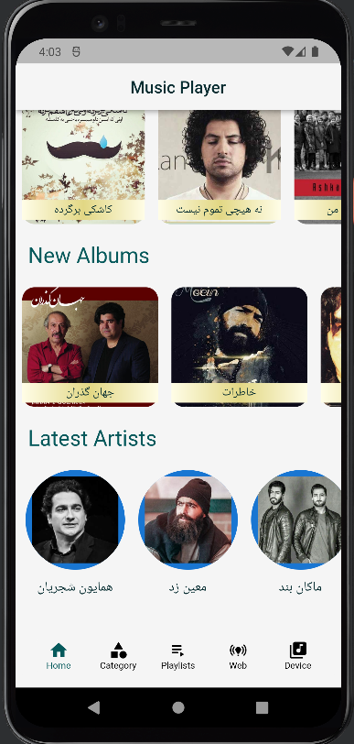
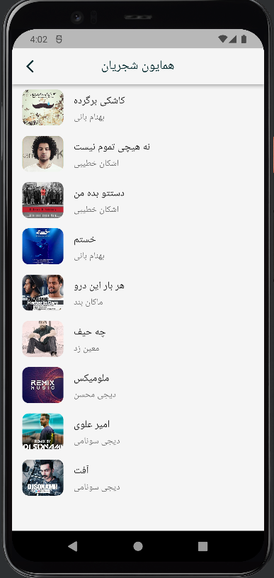
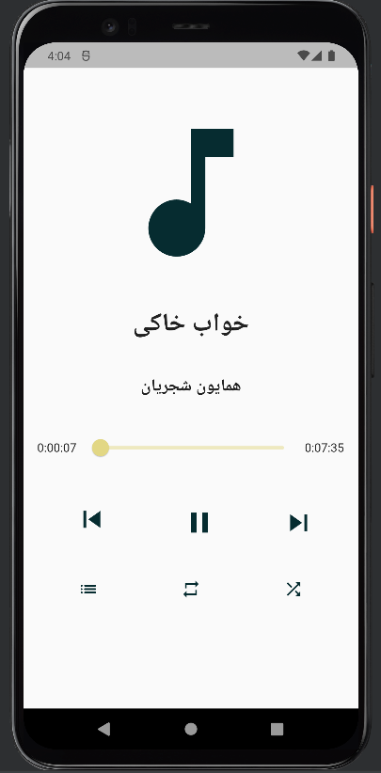
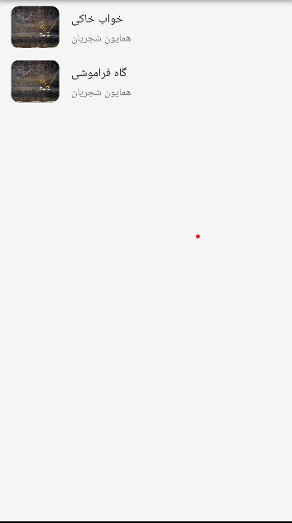
User Interface

Slide 8
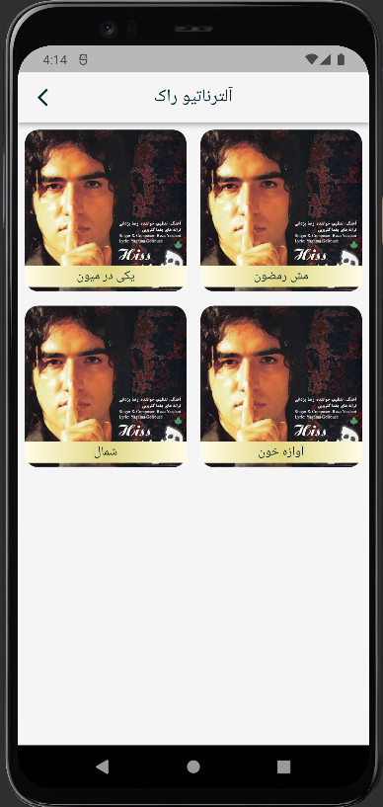
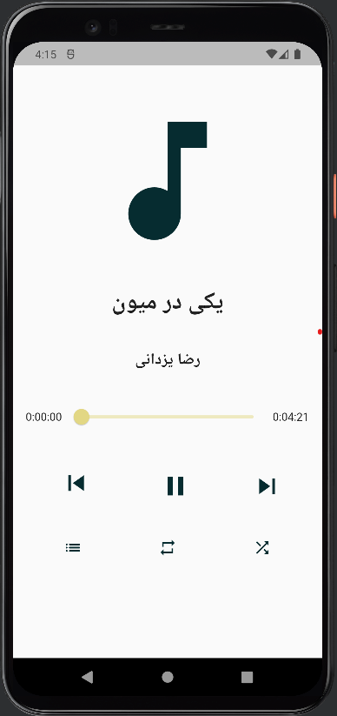
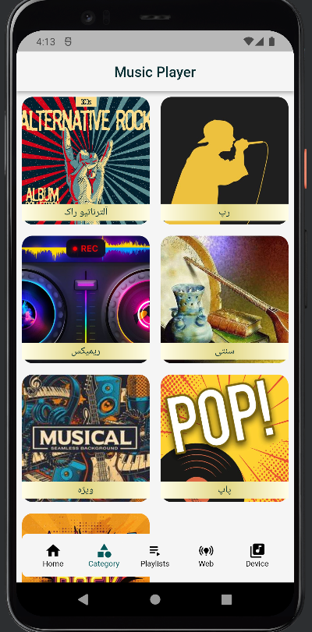
User Interface

Slide 9
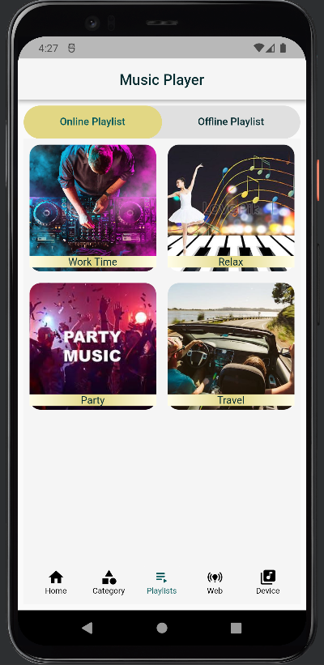
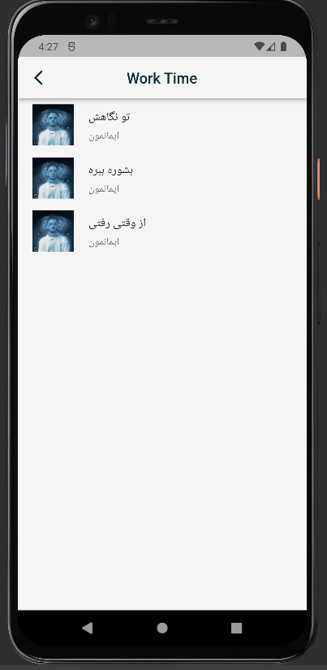
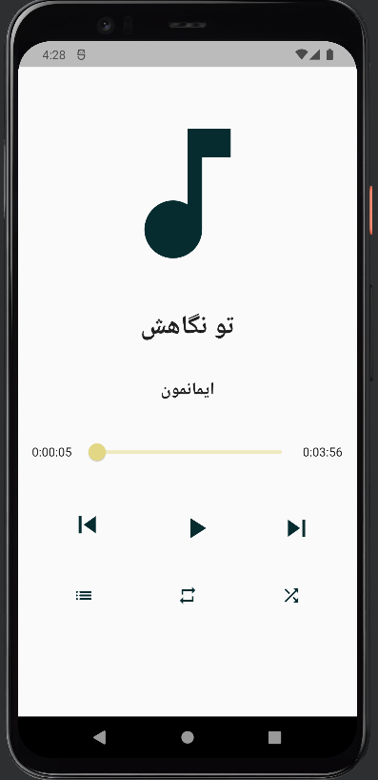
User Interface

Slide 10
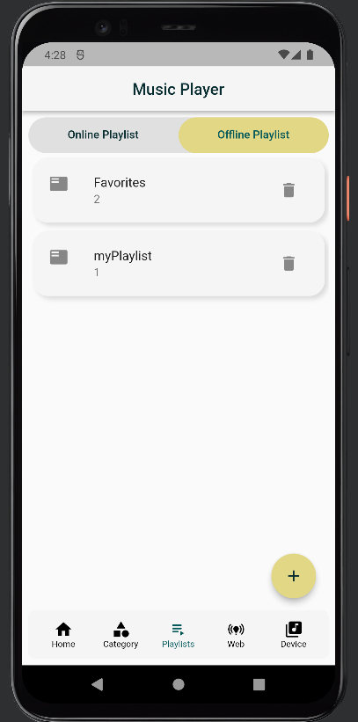
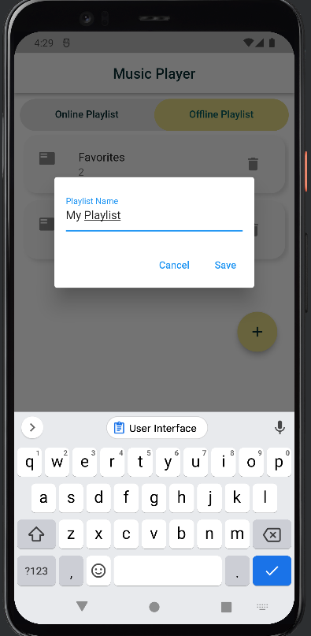
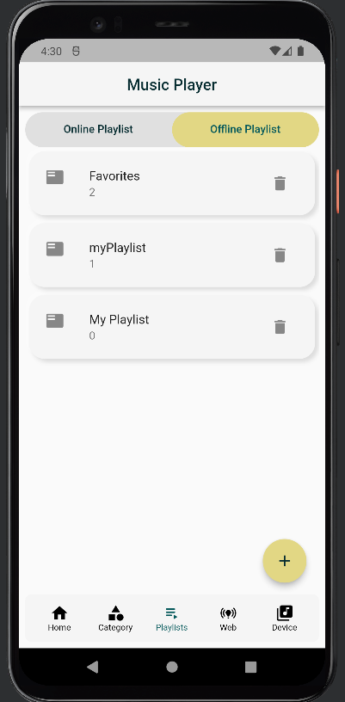
User Interface

Slide 11
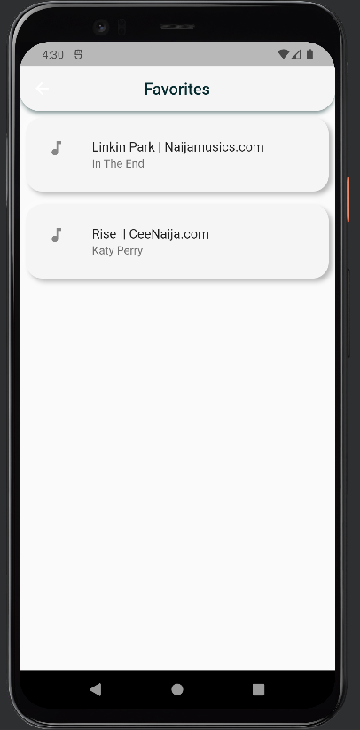

User Interface

Slide 12
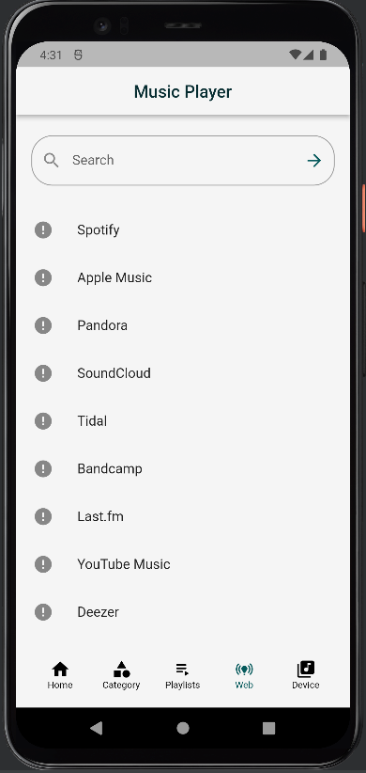
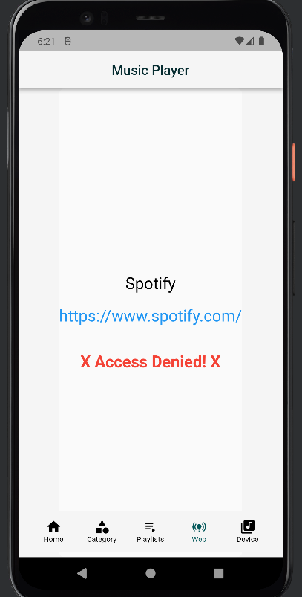
User Interface

Slide 13
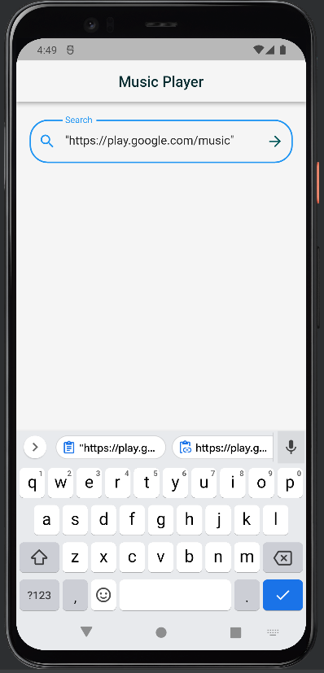
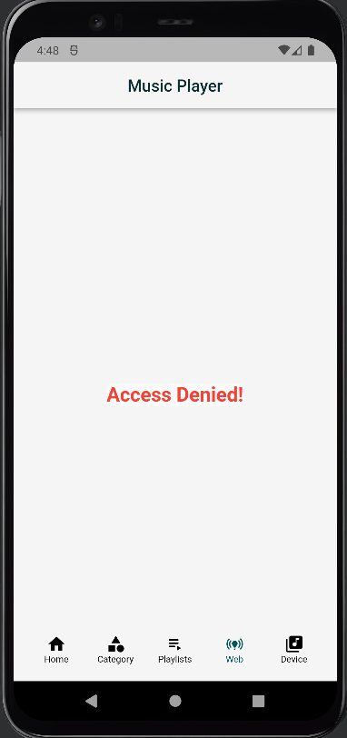
User Interface

Slide 14
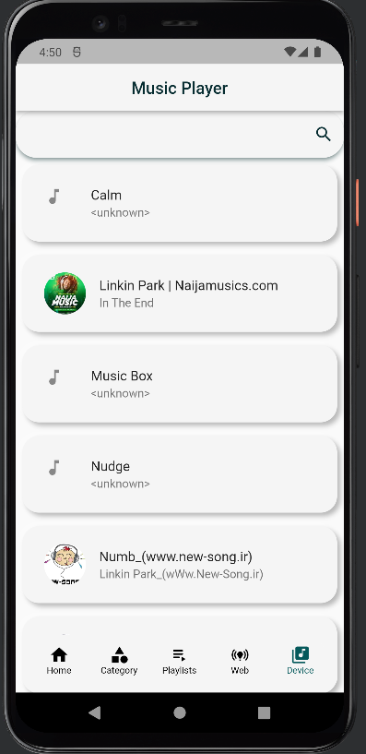
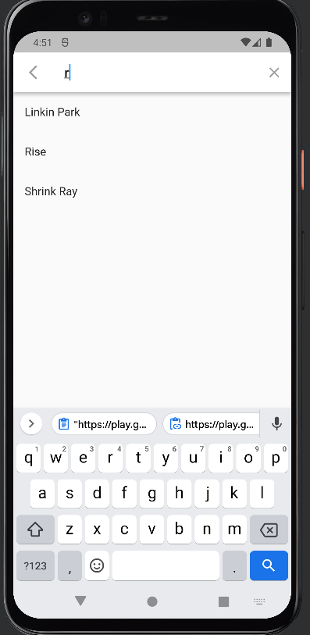
User Interface

Slide 15
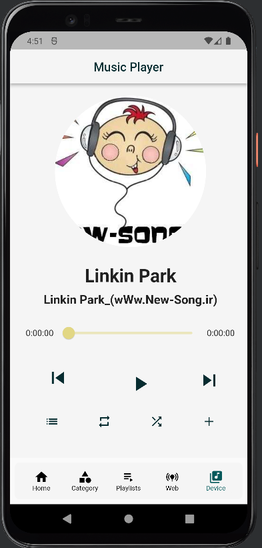
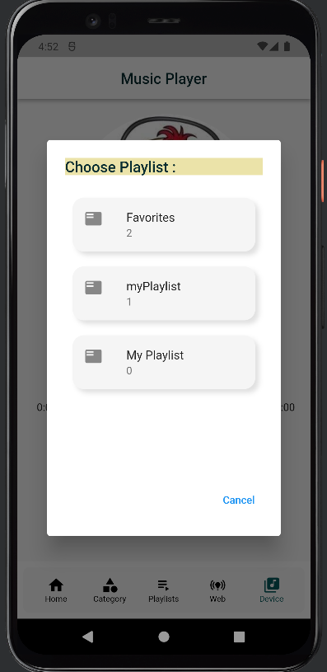
User Interface

Slide 16
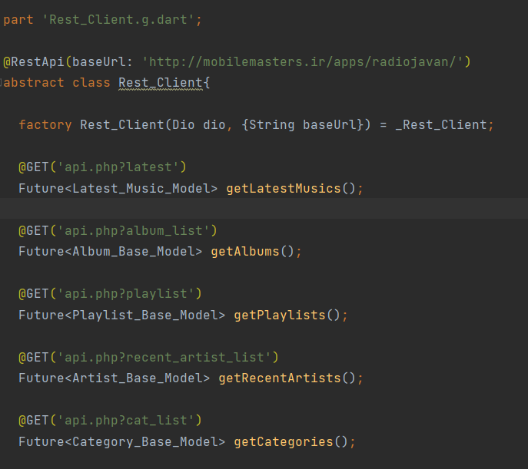
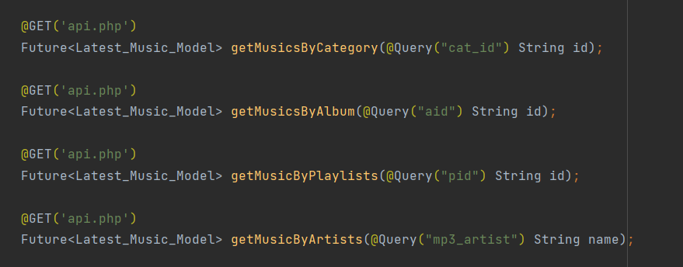
Technical Details
Network Connection
Query Special Songs
Query All Songs

Slide 17
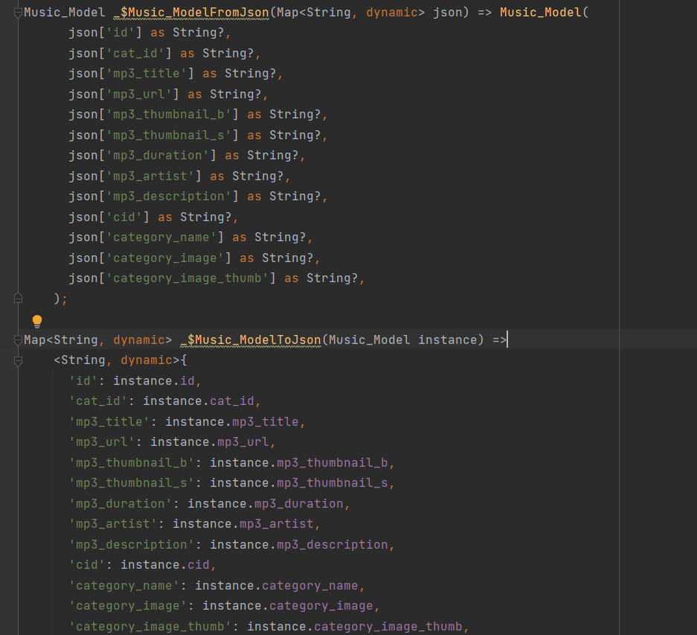
Technical Details
Base Music Model, connecting with the Network (Rest Client) to get Music Model variables and parse them to JSON or Serialization from it.
Other models such as ArtistModel, AlbumModel, CategoryModel, PlaylistModel and LatestMusicModel have the same thing.

Slide 18
Challenges and Solutions
Challenges:
Not Playing Music in Android Studio
Solutions:
Add the following code to the AndroidMainfest.xml file
android:name="androidx.multidex.MultiDexApplication"

Slide 19
Challenges and Solutions
Challenges:
Accessing to Device Storage Songs
Solutions:
Ask user to access the storage with the following codes
void requestStoragePermission() async { // only if the platform is not web. (web has no permission) if(!kIsWeb){ bool permissionStatus = await _audioQuery.permissionsStatus(); if(!permissionStatus) await _audioQuery.permissionsRequest(); } // ensured build methods is called setState(() { }); }

Slide 20
References
https://github.com/Sky-RV/Music-Player
https://www.youtube.com/watch?v=UdJ9Ifjptcg&list=PLhGeZ1SOK_3ARkBKRnVjDDZmv2MDi_0N5&index=2
https://www.youtube.com/watch?v=aZiuSBpnU5g
https://www.youtube.com/watch?v=otIRH2HIFoY&list=PL0kMjh_O0eNdleGLZtd9lIXMioypkqCiJ
https://www.youtube.com/watch?v=fWLlbxCNFKo
https://www.youtube.com/watch?v=PnjeNjCq0k4
https://www.youtube.com/watch?v=T4yeX0uGpow
https://www.youtube.com/results?search_query=online+music+player+with+flutter
https://www.youtube.com/watch?v=QKqLvy7uqCE
https://www.youtube.com/watch?v=iu7sIJh6LZc&list=PLhGeZ1SOK_3ARkBKRnVjDDZmv2MDi_0N5&index=6
http://mobilemasters.ir/apps/radiojavan/index.php
https://stackoverflow.com/questions/50713888/how-to-show-image-from-network-in-flutter-boxdecoration
https://pub.dev/packages/retrofit
https://pub.dev/packages/flutter_image_slideshow/install
https://pub.dev/packages/flutter_text_field_fab/example
https://pub.dev/packages/searchable_listview
https://flutterawesome.com/flutter-plugin-used-to-query-audios-songs-infos-from-device-storage/
https://pub.dev/packages/on_audio_query/versions/2.1.1
https://api.flutter.dev/flutter/widgets/GridView-class.html
https://android-learn.ir/

